Slide 1
Project Presentation
Wind-Energy based Path Planning for Electric Unmanned Aerial Vehicles Using Markov Decision Processes
Sushil Vemuri 19317

Slide 2
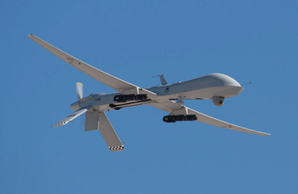
Introduction
Unmanned Aerial Vehicles (UAVs) are small, electric-powered aircraft used in both military and civilian applications.
Coastal or border surveillance, atmospheric and climate research, remote environment, forestry, agricultural, and oceanic monitoring and imagery for the media and real-estate industries are all possible applications for such aircraft.
One of the most significant limitations of small UAVs is their flight endurance due to the limited amount of onboard (fuel/battery) that can be carried.
For planning the best route, it is critical for these vehicles to harness fluctuating and unknown environmental circumstances (horizontal wind, vertical wind) in order to maximise flight length and minimise power usage.
Due of the vehicle's small size, the unpredictable amplitude and direction of the wind can really cause uncontrollable forcing to be applied to it.

Slide 3
Introduction Cont.
In this work, the authors integrate the uncertainty of the wind field into the wind model and use a Markov Decision Process (MDP) for planning.
The authors proposed that because the wind velocity is uncertain, the next horizontal state may be considered a random variable, and a probability distribution can be constructed over all horizontally adjacent cells.
Therefore, given these transition probabilities from all states the motion planning problem is then to select the actions (horizontal and vertical actuation of the balloon) that minimize time to-goal.
The MDP determines for each given current state, what is the optimal immediate action so that the expected cumulative time-to-goal is minimal.

Slide 4
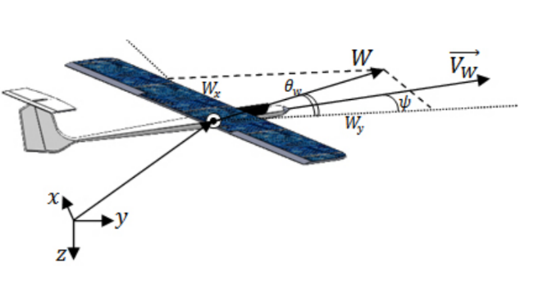

Latitudinal UAV Dynamics
We address this problem as three-dimensional planer problem (movement in three dimensions but not rotation). The three degrees of freedom are represented by the $x−position$, $y−positon$, and heading angle $ψ$. The height of the UAV $z−position$will remain constant.

Slide 5
Path Planning
In this work a Markov Decision Process (MDP) is used to find the optimal wind-energy based path for a UAV in the presence of a wind field distribution which provide the best path to follow to minimise the onboard electric power consumption of the UAV.
As a result, this problem is readily formulated as a Markov Decision Process (S; A; P; R), where S symbolises the set of potential states of the aircraft; A denotes the set of possible actions of the aircraft; The transition probabilities are represented by P. For each transition and action, R defines the expected immediate reward.
MDP Problem Description: Given two points (Start and Target points) compute a path that minimises energy consumption by exploiting an uncertain, time-varying wind field for a UAV.

Slide 6
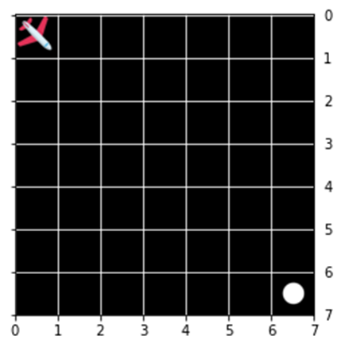
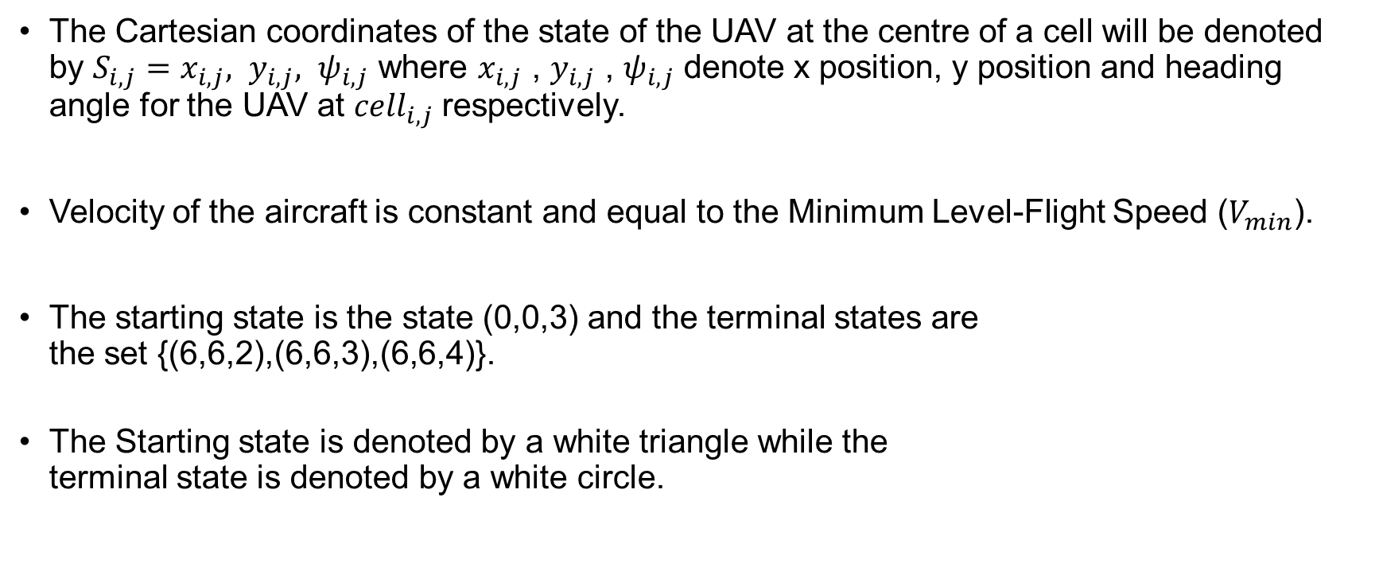
Possible states (S)
The Cartesian coordinates of the state of the UAV at the centre of a cell will be denoted by $S_{i,j}=x_{i,j}, y_{i,j}, ψ_{i,j}$ where $x_{i,j}$ , $y_{i,j}$ , $ψ_{i,j}$ denote x position, y position and heading angle for the UAV at ${cell}_{i,j}$respectively.
Velocity of the aircraft is constant and equal to the Minimum Level-Flight Speed ($V_{min}$).
The starting state is the state (0,0,3) and the terminal states are the set {(6,6,2),(6,6,3),(6,6,4)}.
The Starting state is denoted by a white triangle while the terminal state is denoted by a white circle.

Slide 7
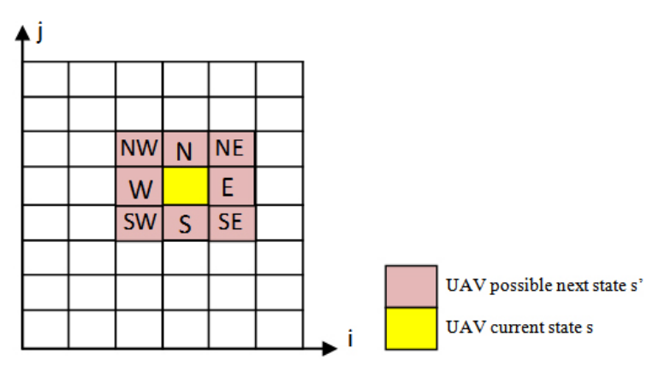
Actions available from each state (A)
We assume that the UAV can move in eight directions, A = N, NE, E, SE, S, SW, W, NW.
Where taking the action N means the heading angle (ψ) is equal to zero degree.

Slide 8
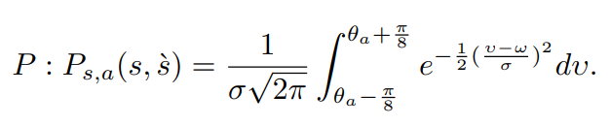
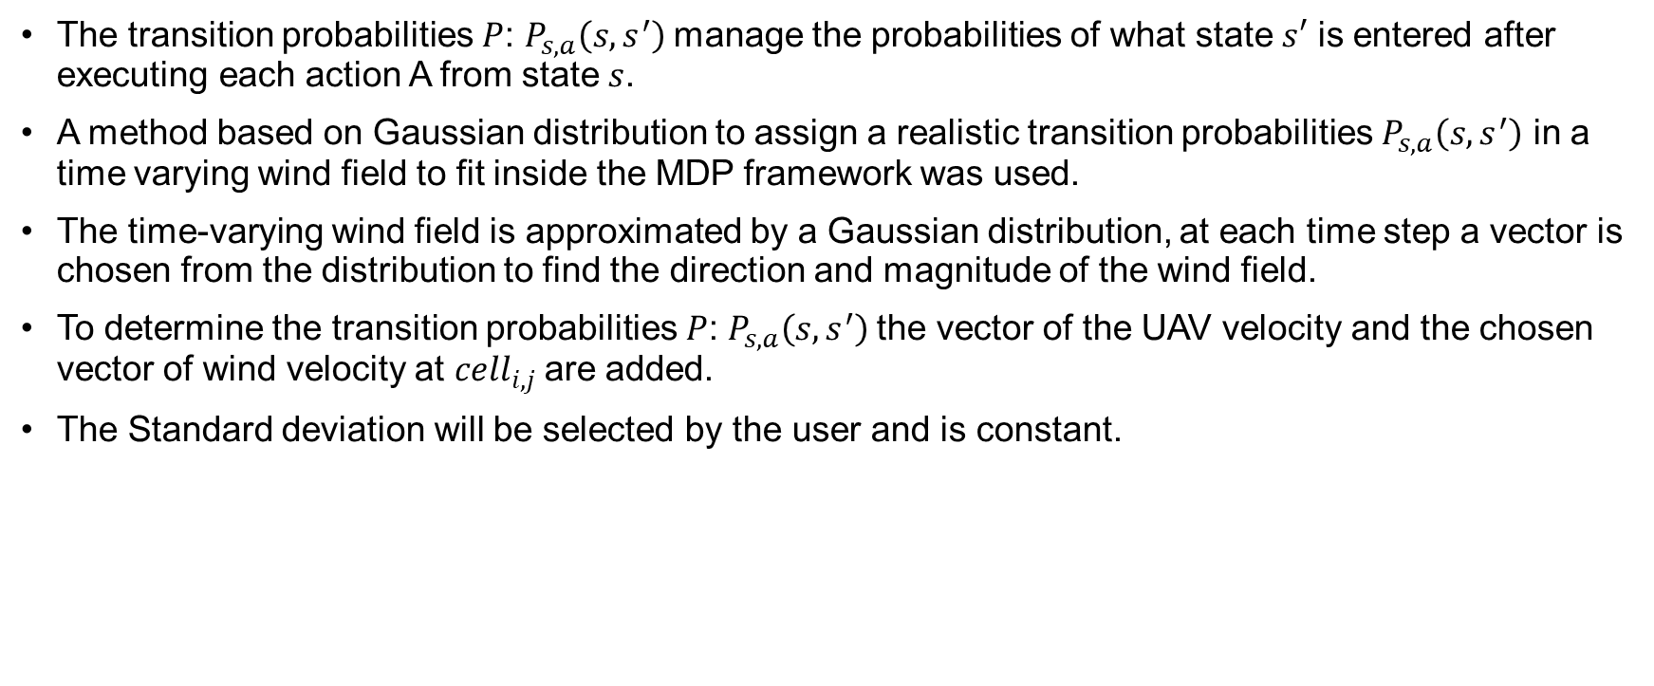
Transition probabilities (P)
The transition probabilities $P$: $P_{s,a}\left(s,s^{′}\right)$manage the probabilities of what state $s′$ is entered after executing each action A from state $s$.
A method based on Gaussian distribution to assign a realistic transition probabilities $P_{s,a}\left(s,s^{′}\right)$ in a time varying wind field to fit inside the MDP framework was used.
The time-varying wind field is approximated by a Gaussian distribution, at each time step a vector is chosen from the distribution to find the direction and magnitude of the wind field.
To determine the transition probabilities $P$: $P_{s,a}\left(s,s^{′}\right)$the vector of the UAV velocity and the chosen vector of wind velocity at ${cell}_{i,j}$are added.
The Standard deviation will be selected by the user and is constant.

Slide 9

Reward for each transition and each action (R)
The ratio between the wind component facing the target point and the maximum expected wind value will be calculated and multiplying the result by a weight (C) - where (C) is selected by the user
To this 2C was added if the UAV was in its target state and -5 was added in all other states.

Slide 10

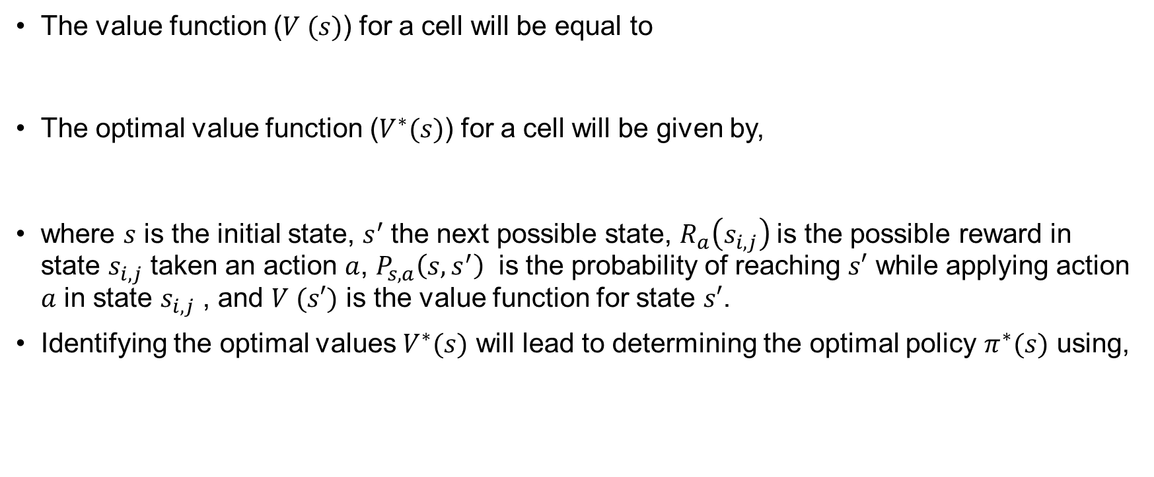
Finding Optimal Policy
The value function ($V (s)$) for a cell will be equal to
The optimal value function ($V^{∗}(s)$) for a cell will be given by,
where $s$ is the initial state, $s^{′}$the next possible state, $R_{a}\left(s_{i,j}\right)$is the possible reward in state $s_{i,j}$ taken an action $a$, $P_{s,a}\left(s,s^{′}\right)$ is the probability of reaching $s′$ while applying action $a$ in state $s_{i,j}$ , and $V (s′)$ is the value function for state $s′$.
Identifying the optimal values $V^{∗}(s)$ will lead to determining the optimal policy $π^{∗}(s)$ using,

Slide 11
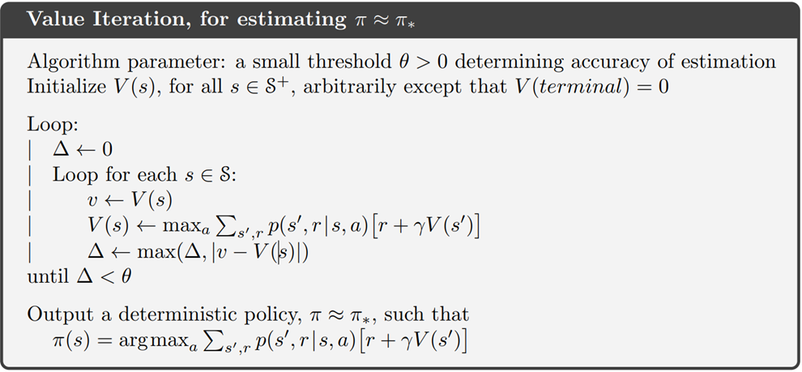
Value Iteration
The value Iteration algorithm was implemented to generate the optimal policy.

Slide 12
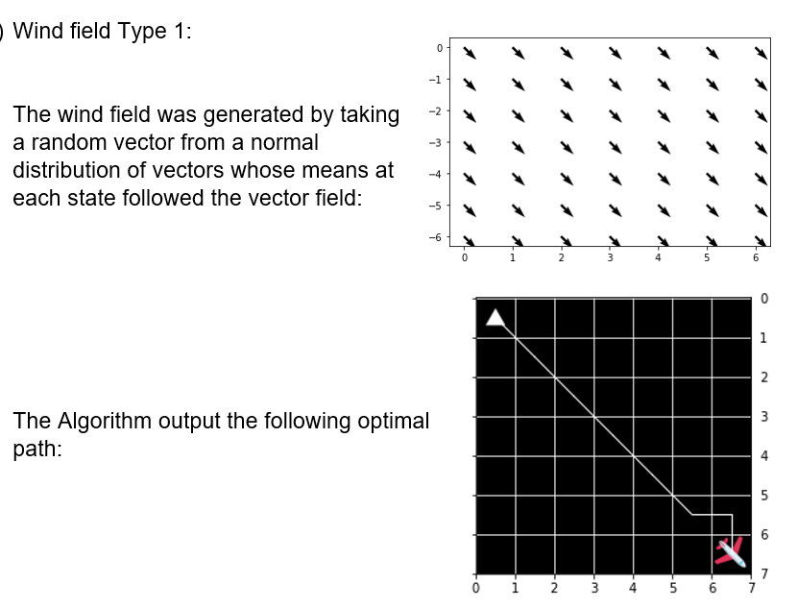
Results (Wind field 1)

Slide 13
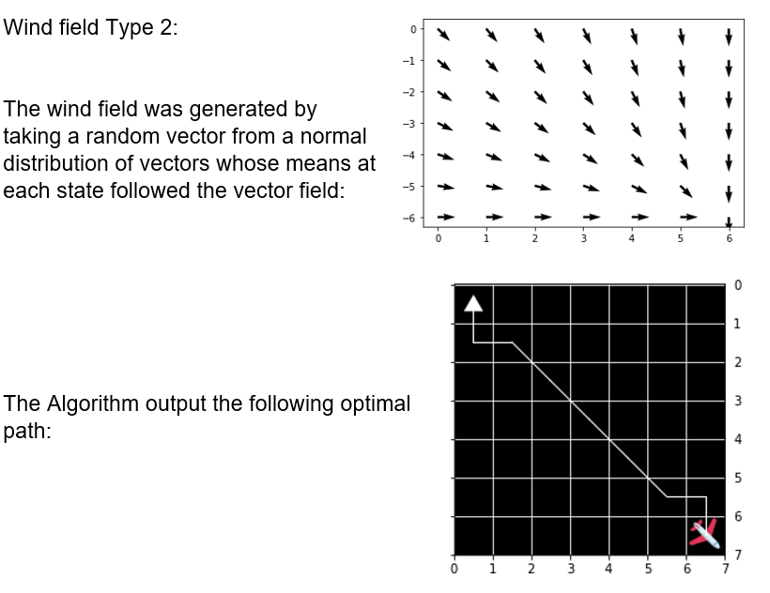
Results (Wind field type 2)

Slide 14
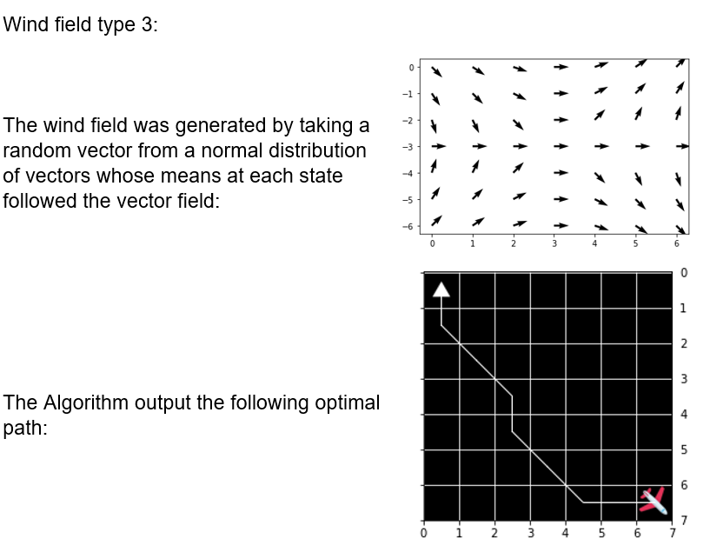
Results (Wind field type 3)

Slide 15
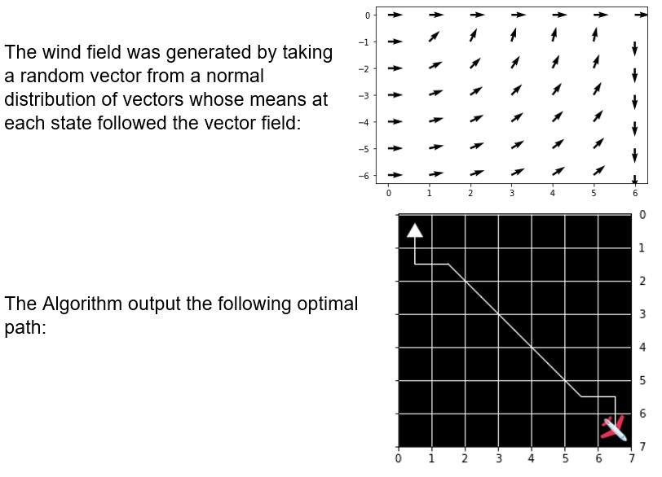
Results (Wind field type 4)

Slide 16
Interpreting Results
The algorithm seems to have output the optimal path in case of wind field 1, 2 and 3 but the path in case of wind field 3 does not seem to be the most optimal one.
This may be because the -5 reward given for each step may be overpowering the reward due to movement in direction of wind and causing the episode to try to terminate as quickly as possible. This causes the agent to not take longer paths even if it consumes less fuel in doing so.

